Slide 1

Be There for your Movement

Slide 2
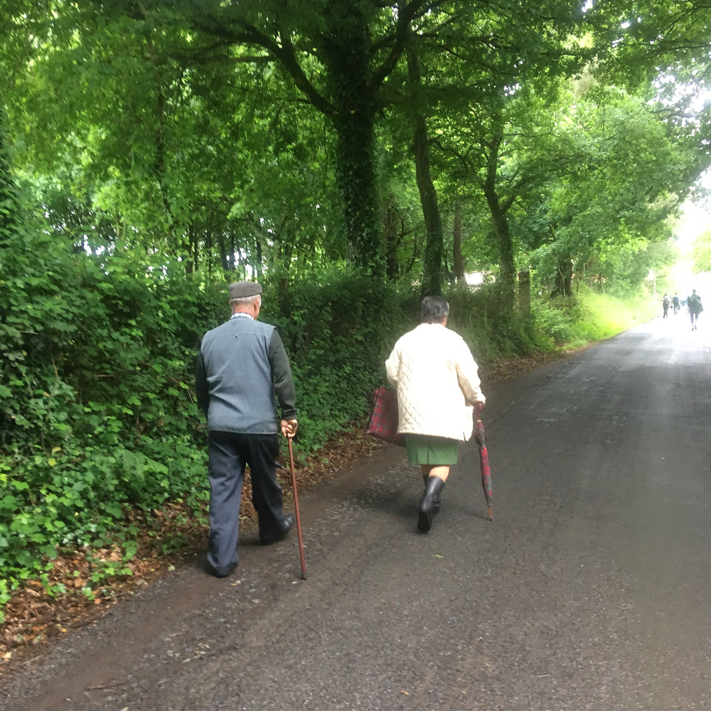
What we will cover
  Define how mindfulness applied to movement can alleviate mental, emotional and physical stress.
  Learn an approachable way to become familiar with mindfulness as a multi-faceted practice.
    Why Practice mindful movement
    What to do to in mindful movement
    How to approach mindful movement
    Practical exercises & applications

Slide 3
Why, Mindful Movement
Mindfulness in Research
  Mindfulness is positively associated with cardiovascular health, with the associations particularly driven by smoking, body mass index, fasting glucose, and physical activity.
  Mindfulness is associated with better psychological well-being, coping, and quality of life
  In a study performed with nursing students findings indicated that both therapies (exercise and mindfulness meditation) were effective in the management of depression. However, mindfulness meditation was more effective than physical exercise.
  Older adults indicated that the mindfulness training increased their awareness and self-reflection and fostered a more self-accepting attitude. Furthermore, they improved their self-care habits and reported having better familial and social relationships.
  Performance outcome in sports, physiological and psychological surrogates improved to a meaningful extent following mindfulness practice, as well as performance outcomes

Slide 4
Mindfulness: Mind Body Connection
Accepting your body is crucial for your peace and freedom. Every human being is born as a flower in the garden of humanity. And flowers differ from each other. If you can’t accept your body and your mind, you can’t be home for yourself. When you practice building a home in yourself, you become more and more beautiful. You radiate your inner peace, warmth, and joy.
-Thich Nhat Hanh
The secret of health for both mind and body is...live the present moment wisely and earnestly.
-Gautama Buddha

Slide 5
Mindfulness & Daily Living
As you will see, mindfulness practice does not need to be another “add-on.” Its beauty lies in the fact that it can be fully and easily integrated into every act of our daily living, reminding us to live the present moment fully.
― Thích Nhất Hạnh

Slide 6
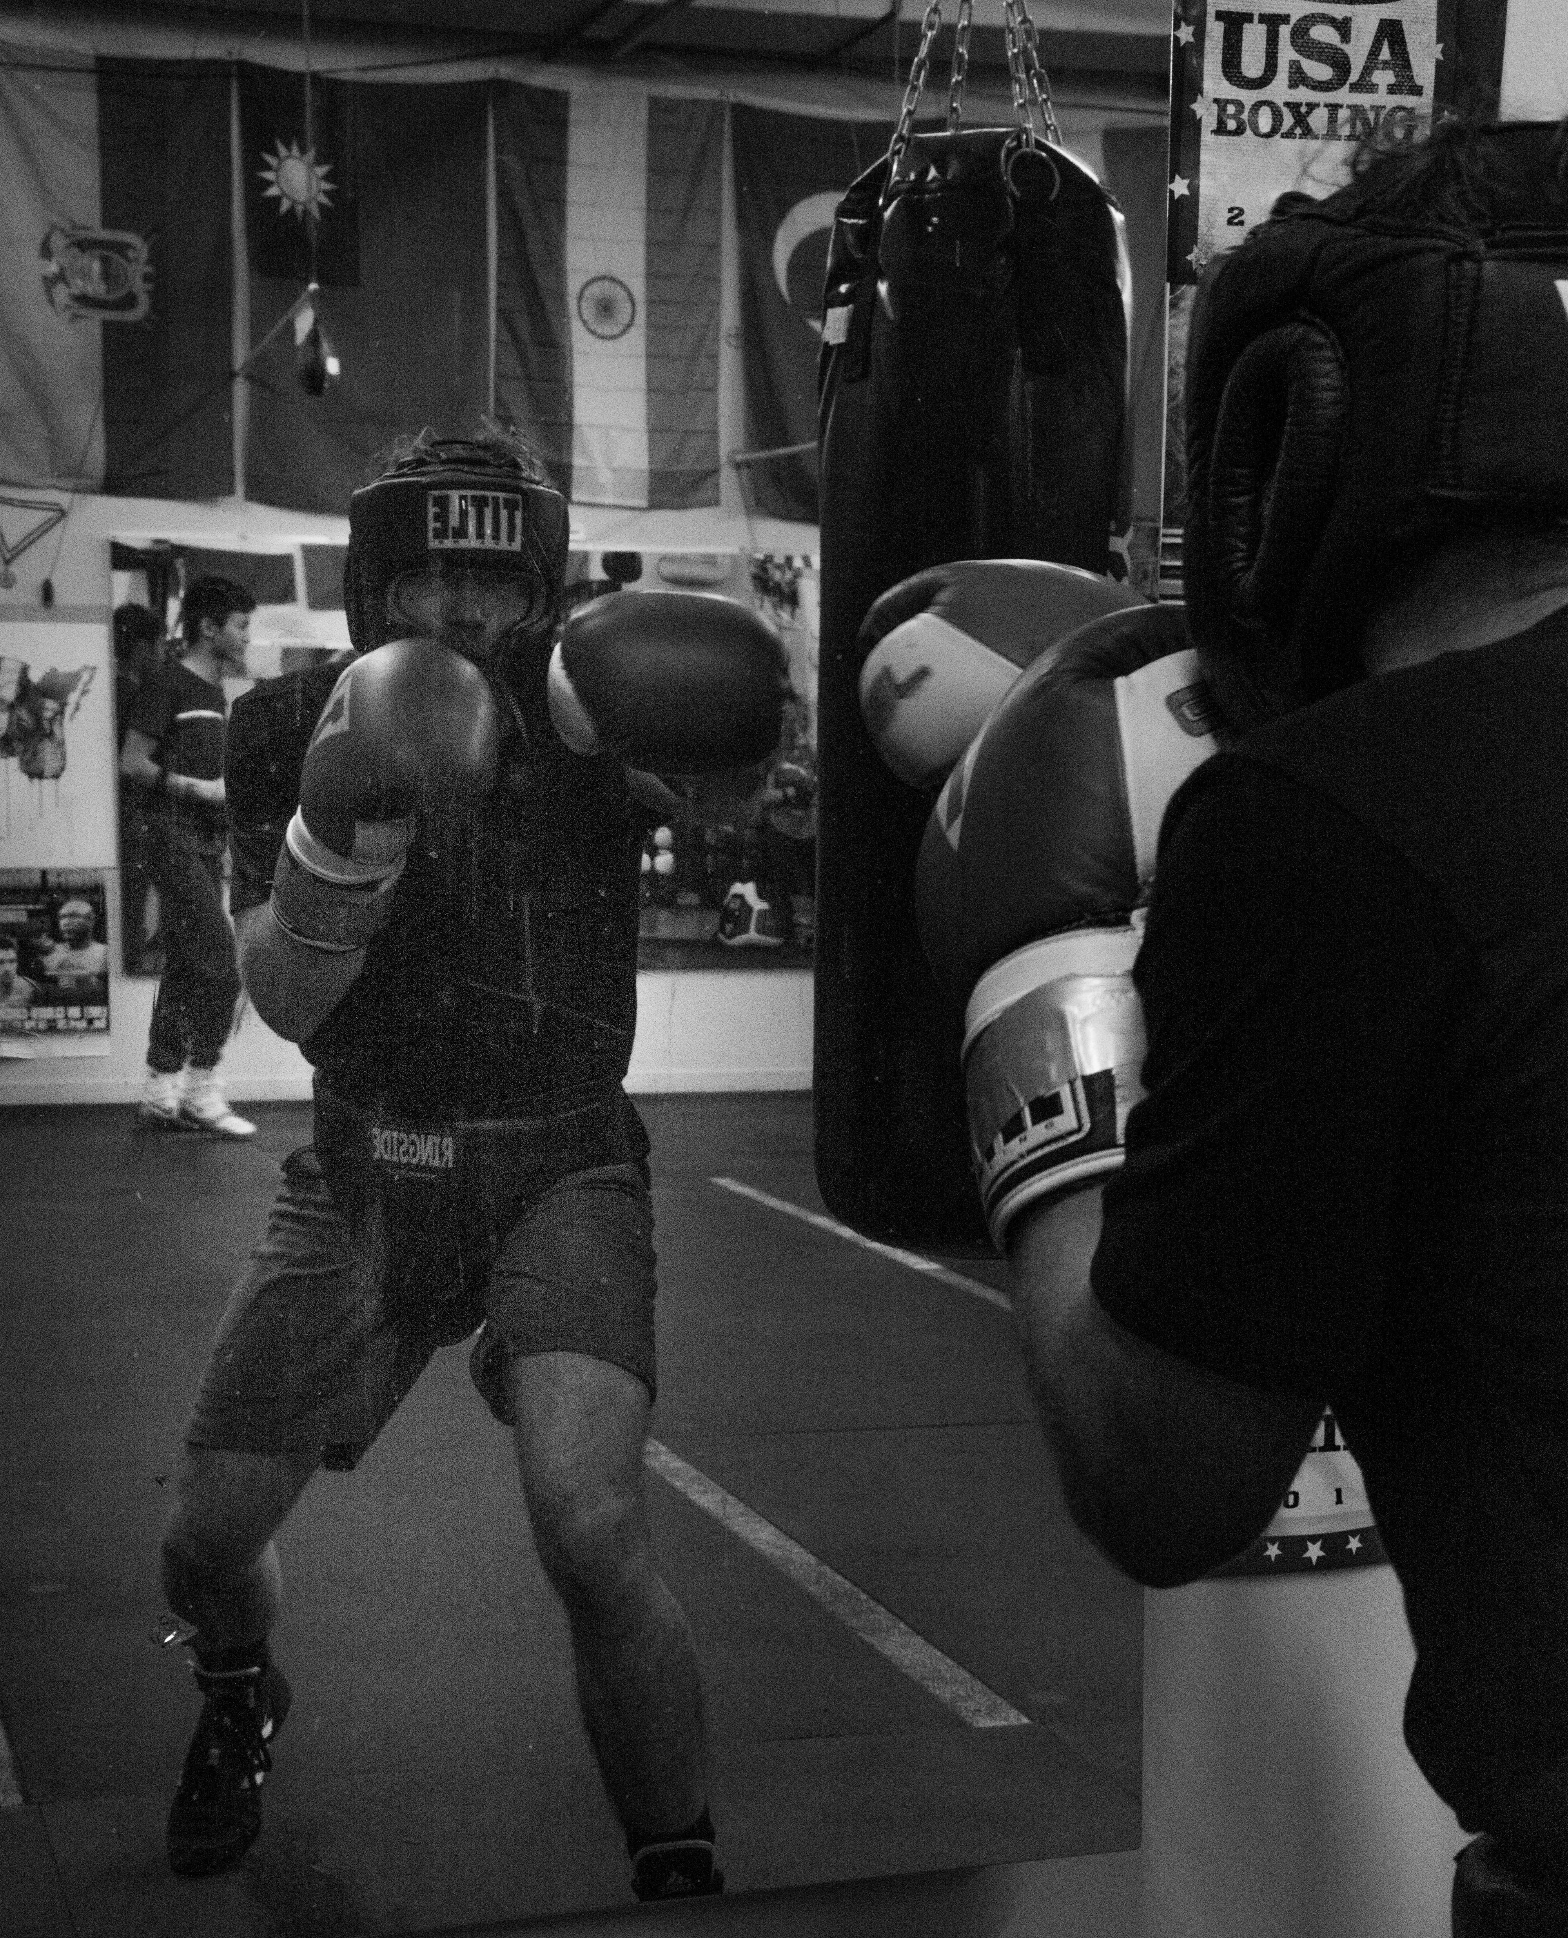
What of Mindfulness
Observe
Describe
Participate

Slide 7
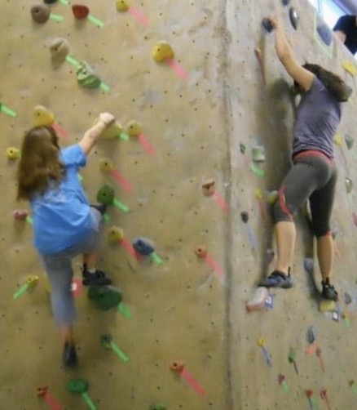
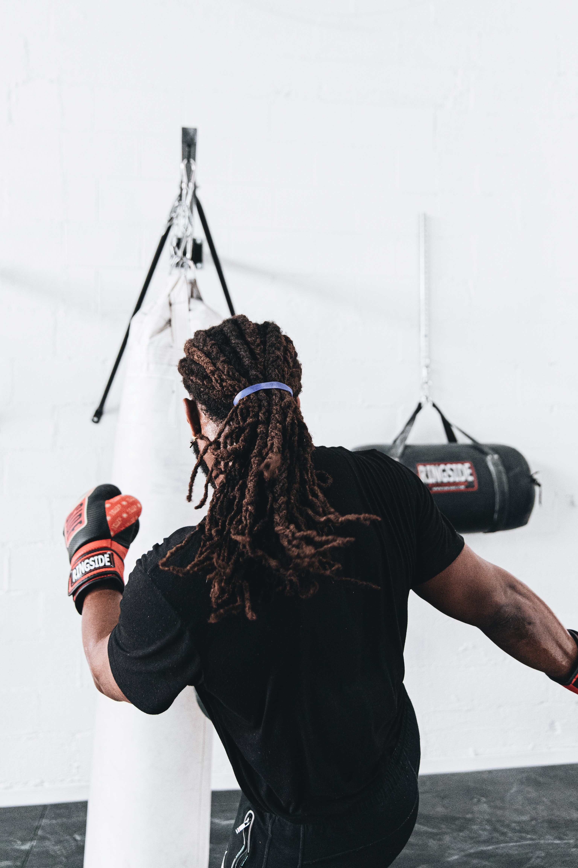
What of Mindfulness
Observe
  Notice your environment
  Pay attention to body sensations
  Focus your attention
  Practice watching thoughts and emotions
  Observe both inside and outside yourself

Slide 8
What of Mindfulness
Describe
  Put words on the experience
  Label what you observe
  Watch for your interpretations and opinions
  Focus on the senses and put into words

Slide 9
What of Mindfulness
Participate
  Throw yourself completely into the activity
  Become one with whatever you are doing
  Act intuitively, what is needed for the situation
  Go with the flow, respond with spontaneity

Slide 10
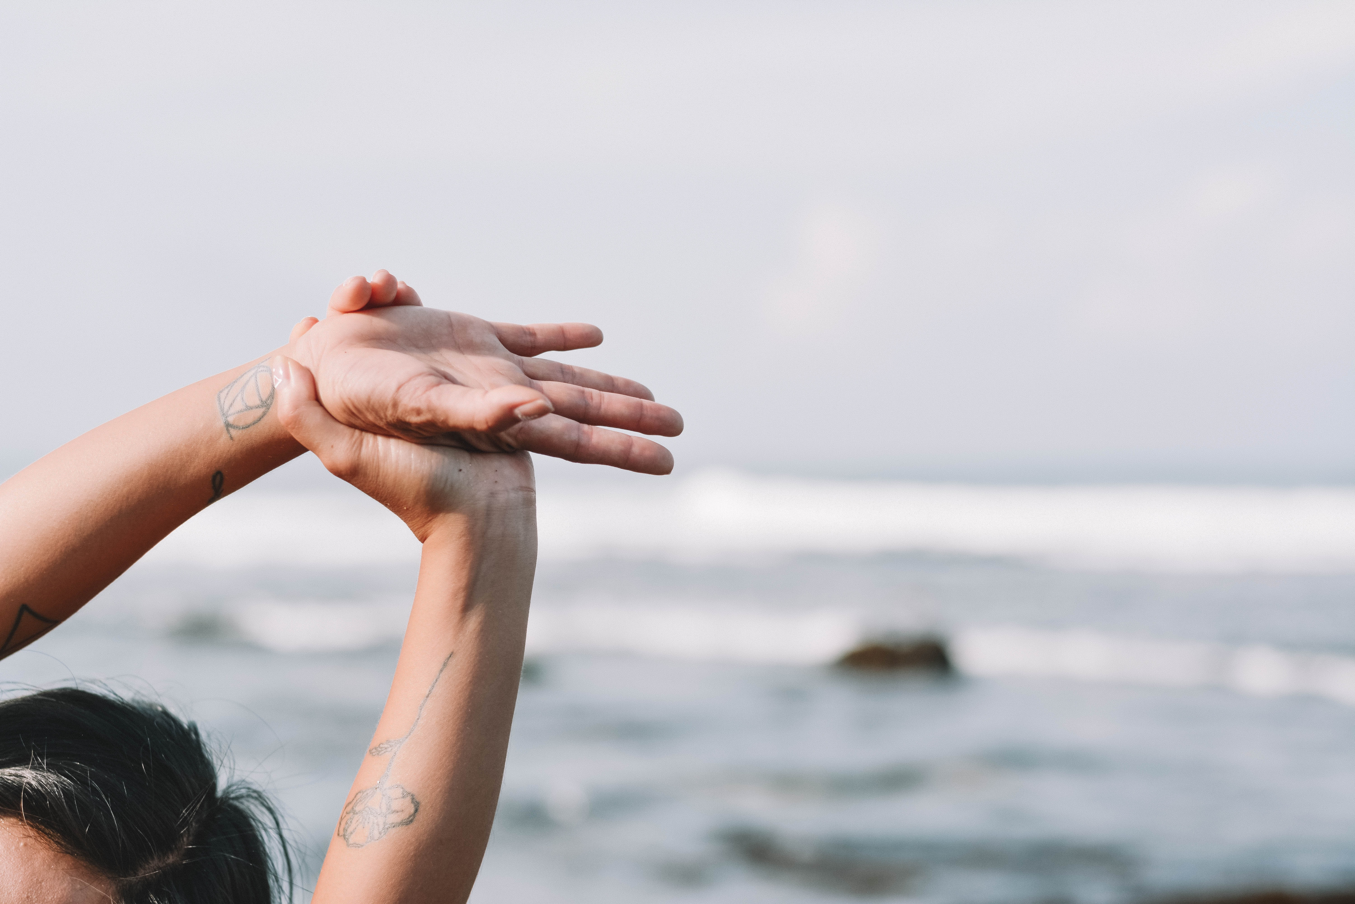
How of Mindfulness
Nonjudgmentally
One-Mindfully
Effectively

Slide 11
How of Mindfulness
Nonjudgmentally
  See but don’t evaluate as good or bad
  Accept each moment
  Acknowledge but don’t judge
  Watch to not judge your judging

Slide 12
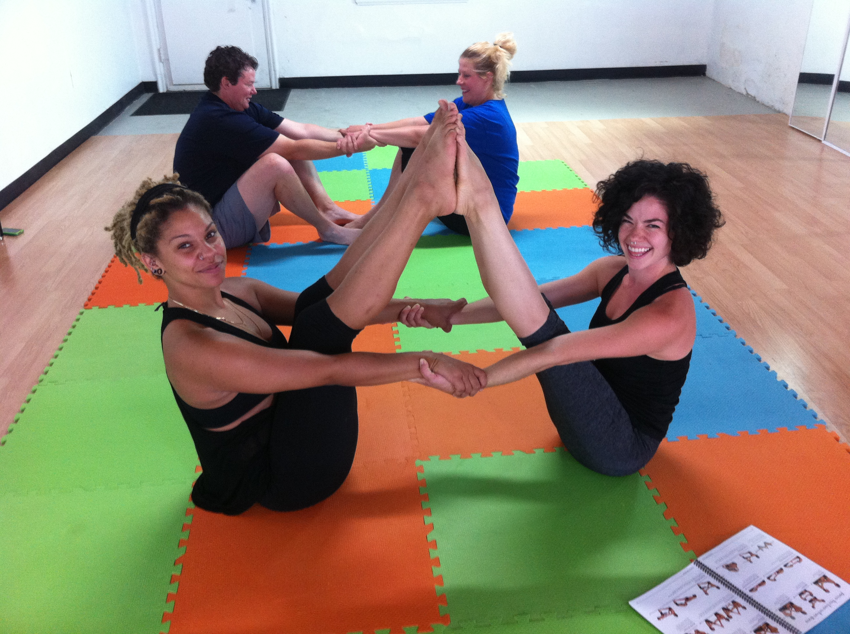
How of Mindfulness
One-Mindfully
  Drop completely into the moment
  Do one thing at a time
  Let go of distractions
  Concentrate your mind

Slide 13
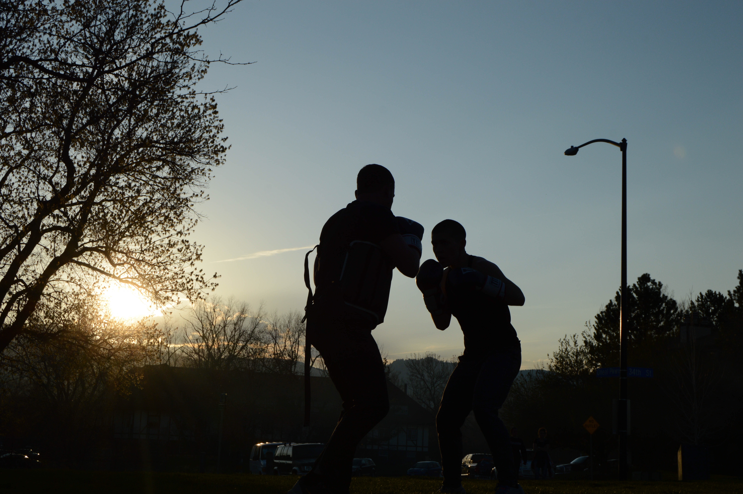
How of Mindfulness
Effectively
  Practice awareness of your goals
  Focus on what works
  Act as skillfully as you can
  Be willing

Slide 14
Mindful Movement Applications
Observe (Nonjudgmentally, One Mindfully, Effectively)
  Environment
  Urges
  Emotions
  Breathe
  5 senses

Slide 15
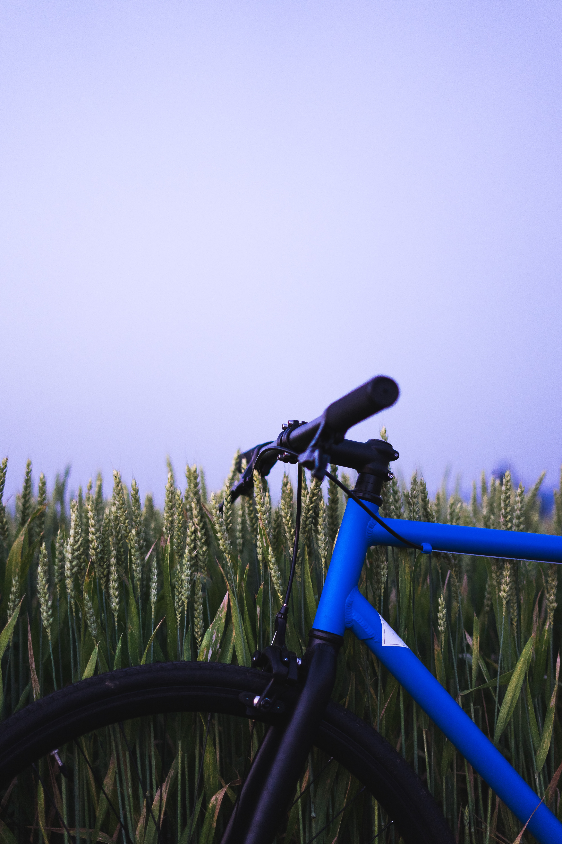
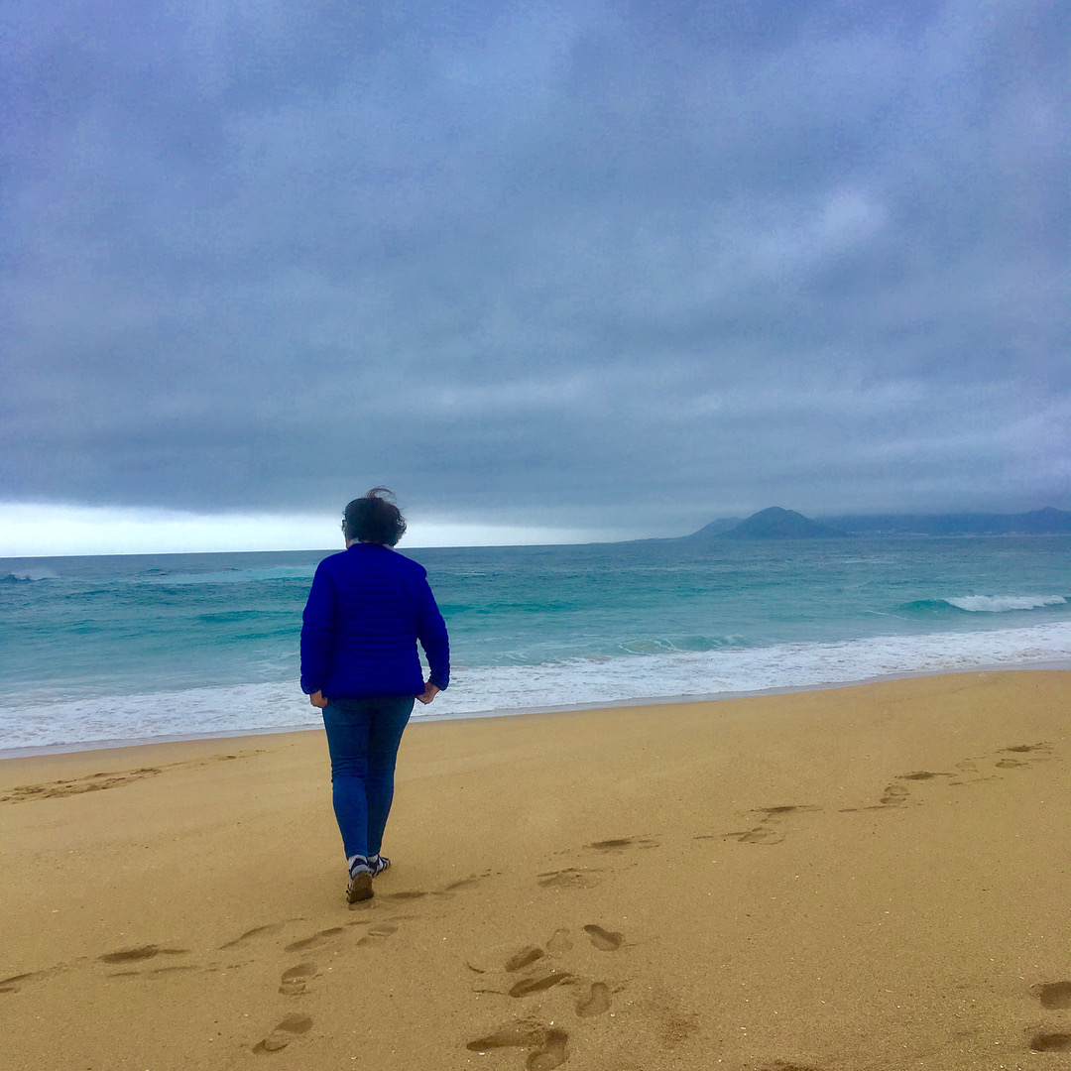
Mindful Movement Applications
Describe (Nonjudgmentally, One Mindfully, Effectively)
  The origin of this movement practice
  Put into words what you notice from your senses
  The experience of movement
  The thoughts associated with the experience of movement

Slide 16
Mindful Movement Applications
Participate (Nonjudgmentally, One Mindfully, Effectively)
  Be mindful of your movement in silence and bring all your attention to your experience
  Connect with the pleasure
  Let go of other distractions
  Take moments in a movement practice to fully immerse yourself in one aspect of the experience

Slide 17
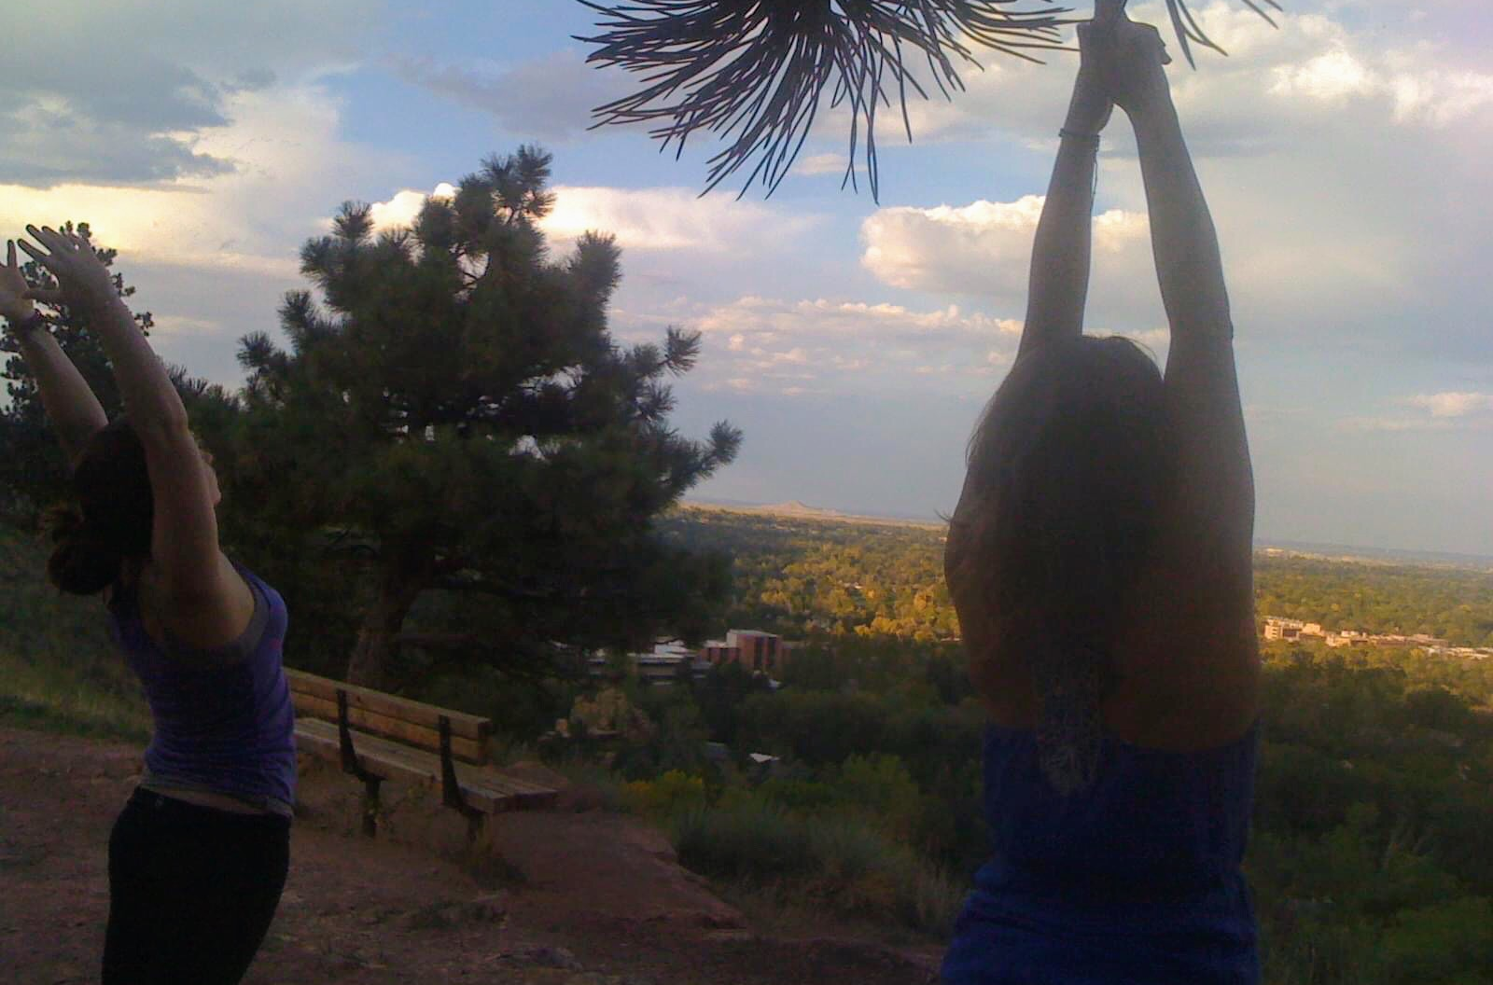
10 Trauma Sensitive Yoga Poses

Slide 18
10 Trauma Sensitive Yoga Poses
These poses are useful for quieting the mind by engaging the parasympathetic
nervous system, lowering heart rate and increasing heart rate variability. The
poses have been selected with particular awareness for the needs of abuse
survivors. The sequence is designed to optimize a feeling of grounded calm. As
with all these trauma resources, we teach that you must use these resources for
your self-care first, before attempting to teach others.
1) Mountain: Stand with your feet together or hip width apart. Broaden your
collarbones; lift your chest. Allow your arms to drape down with the palms turned
outward. Feel your feet extend into the ground. Lengthen the crown of your head
up into the sky. Imagine you have the strength and quiet grace of a mountain.
Inhale deeply to your collarbones. Exhale out through your feet and the crown of
the skull. Inhale, make fists with your hands and then exhale, release them,
opening the palms wide. Gather your strength from the earth on the inhale;
release your effort into the sky with your exhale. Come back to stillness, noticing
your breath and the movement inside you, watching the breath. Come
back to Mountain pose. Notice the breath.

Slide 19
10 Trauma Sensitive Yoga Poses
2) Salute the Sun: Feet firmly planted into the ground:
Inhale, drawing both up arms up along your ears.
Exhale, bringing arms back down to your sides.
Inhale, drawing them up again, extending your fingertips to the sky. Exhale and
lower your left arm to your thigh
Inhale, doing a side bend with the right arm extended to the sky and the left arm
lengthening down the thigh
Exhale, imagine the sun rising in the east
Inhale, reaching the left arm up and the right arm down.
Imagine the sun setting into the west.
Exhale as you reach into the sky. Repeat 3 times, watching the breath. Come
back to Mountain pose. Notice the breath.

Slide 20
10 Trauma Sensitive Yoga Poses
3) Wide Angle: From Mountain, bring your hands to your hips and step your feet
about 3 - 4 feet apart depending on the length of your legs. Keep feet parallel.
Inhale, clasping your hands together and draw them up to the sky, turning the
palms upward.
Exhale, releasing your hands and extending your arms, fingertips out to the
horizon. Inhale, clasping your fingers together again in front of you and
Exhale, reaching up to the sky.
Inhale back to extended arms.
One more time – inhale and clasp your fingers together again in front of you and
exhale reaching up into the sky. Inhale, back to extended arms. Bring your hands
to your hips and either jump both feet together or step back to Mountain pose.
Notice the breath.

Slide 21
10 Trauma Sensitive Yoga Poses
4) Warrior 1: From Mountain, step the feet apart to Wide Angle. Inhale draw the
arms to shoulder height.
Exhale, reaching the fingers into the horizon.
Inhale, turning the right foot out and the left foot slightly in.
Exhale, bending the right knee over the ankle.
Inhale, drawing the left arm down and forward and both arms up to frame the
ears. Reach your fingers into the sky. Square the hips.
Inhale and exhale for three breaths.
Inhale, straightening the right leg, parallel the feet return to Wide Angle.
Notice the breath.
Repeat but this time on the left side.

Slide 22
10 Trauma Sensitive Yoga Poses
5) Warrior 2: From Mountain step the feet apart to Wide Angle. Inhale, bringing
the arms to shoulder height.
Exhale, reaching the fingers into the horizon.
Inhale deeply
Exhale, turning the right toes out.
Inhale, bending the right knee over the ankle
Exhale, turning to look over your right fingertips
Keep the gaze steady but soft and the chest stacked over the hips. Inhale and
exhale slowly for three breaths.
Inhale, straightening the right leg
Exhale, bring feet parallel.
Notice the breath. Repeat on the Left side.

Slide 23
10 Trauma Sensitive Yoga Poses
6) Peaceful Warrior: From Warrior 2 on the right side, keep the knee bent over
the ankle. Inhale, raising the right arm to the sky and lower the left arm to left leg
Exhale into the side body. Hold for three breaths gently reaching down and up
with the hands, feet firmly planted into the ground. Inhale come back to Warrior
2, exhale straighten the right leg. Move through Wide Angle to repeat on the Left
side.
7) Triangle: From Mountain, step the feet apart to a wide angle. Inhale the arms
to shoulder height. Exhale: reach the fingers into the horizon. Inhale deeply into
your chest; exhale and turn the right toes out. Inhale: begin to crease at the hips
and exhale gently; bring the right hand to the thigh or shin or maybe the ground.
Keep the thigh muscles engaged to protect the knee or slightly bend the knee.
Inhale and turn the gaze to the left hand. Exhale: reach into sky. Hold for three
breaths if possible. Inhale: firmly plant the feet into the ground and return to
standing. Exhale and bring the feet parallel and come back to wide angle. Notice
the breath. Repeat on the left side.

Slide 24
10 Trauma Sensitive Yoga Poses
8) Tree Pose: (This pose can be modified depending on the members’ flexibility.)
From Mountain, shift the weight slightly to the left foot. Draw the right knee up.
Bring the right hand to the right ankle and gently place the sole of the foot along
the inner left thigh or along the left calf or ankle. Use the gaze to help achieve
balance by focusing gently on a spot 45 degrees in front of you.
Inhale, drawing the hands together at the heart in prayer position.
Exhale, open the chest and square the shoulders, perhaps lifting the gaze up.
Feel the feet rooted into the earth. Feel the gentle sway of the body as it shifts
and balances. Hold for three breaths or as long as is comfortable. Consider
drawing the arms into the sky as tree branches reaching upward.
Inhale, drawing the knee back up
Exhale gently and come back to Mountain. Repeat on the left side. Notice the
breath.

Slide 25
10 Trauma Sensitive Yoga Poses
9) Forward Fold: (This can be done seated on the floor, on a chair or on the
floor with a chair placed in front of group members to rest their upper body on.)
Seated on the floor, extend the legs together, place the palms on the ground
beside the hips and broaden the collarbones. Inhale and exhale slowly. Gently
flex and point the toes to loosen the ankles. Bring the feet to a neutral position
(as if they were standing on the ground).
Inhale, reaching the arms up and gently folding forward at the hips to place the
hands on the thighs, shins, ankles or feet, depending on comfort level.
Exhale deeply.
Inhale, lengthening the spine while still folded and exhale: release forward and
down. Keep the knees slightly bent. Hold for five breaths, lengthening the
exhalation.
Inhale, reaching forward and up, gently raising the upper body.
Exhale and come back to a seated position.

Slide 26
10 Trauma Sensitive Yoga Poses
(9 Continued) Seated in a chair, find that the feet are parallel and hip width apart and that they
connect to the floor. If the feet do not reach the floor, books or other props can be
used. Feel the weight of the body on the chair, the feet connected to the floor.
Place the hands on the knees.
Inhale, extend the spine up and forward, straightening the arms to whatever
degree possible Exhale, and gently drape down over the lap. Arms can hug the
legs or take opposite arm to opposite elbow. Hold for 5 breaths, lengthening the
exhalation. Inhale and slowly roll up to a seated position.
Notice the breath.

Slide 27
10 Trauma Sensitive Yoga Poses
10) Easy Pose with Cat & Cow and Spinal Twists: (This can be done seated
on the floor or on a chair.) Seated on the floor, cross the legs at the mid shin. If
on a chair, keep the knees over the ankles and the feet parallel, hip width apart.
Bring the hands to the knees. Lengthen the spine upwards. Broaden the
collarbones outward. Inhale to the collarbones.
Exhale slowly
Inhale, rounding the spine, lowering the chin to the sternum
Exhale and gently arch the back, lifting the gaze. Repeat two more times,
deepening the twist. Return to neutral. Notice the breath. Take the right hand to
the left knee and the left hand behind you to the floor or the back of the chair.
Inhale, lengthening the spine. Exhale: gently twisting the spine Repeat two more times. Inhale back to the center and take a counter twist to the right. Take the left hand to the right knee
and the right hand behind you to the floor or the back of the chair.
Inhale, lengthening the spine. Exhale, gently twisting the spine Repeat two more times, while deepening the twist. Inhale back through center and take a counter twist to the left. Notice the
breath.

Slide 28
10 Trauma Sensitive Yoga Poses
** Restore Pose: Lowers the heart rate and blood pressure and works very well
to help in Grounding. Use a simple chair with no arms. if the chair has a back,
place it sideways. From seated, bring the back to the ground. Place the calves,
ankles and feet onto the chair so that the lower legs are completely supported.
Encourage group members to bring one hand to their heart and the other to the
belly. Slightly tucking the chin will help to quiet the mind. Feel the chest rise and
fall with each breath; feel the weight of the body on the floor. Allow the floor to
completely support and hold. Remain here for 5 to 10 minutes.
Bring them out of this gently by asking them to inhale deeply, exhale deeply,
lengthening the exhalation. Roll the wrists and ankles; then gently draw the
knees to the chest and roll to the side. Press the ground away and slowly roll up
to seated.

Slide 29
A Mindful Movement Script
Embodied Mindful Awareness- 7- 12 minutes
As the sound of the bell dissolves, begin to bring attention again to your calming anchors- your breath, your feet, your seat.
Check in with your body and notice any areas of tension. Where are you experiencing tension?
As you notice any areas of tension, stretch in response to the needs of the moment.
From a standing position, find two or three stretches or movements that gently address the tension areas.
You may have a favorite series of stretches or you may want to work with our Trauma Sensitive Yoga Poses that are found in the INDEX.
Move in a slow and unhurried pace. Follow your breath and deepen into the experience of being embodied.
Bring your awareness to your moment-to-moment sensory awareness.
Gently notice what calls for your attention in your body.
Notice that sensations come and go, range in intensity, even disappear…

Slide 30
A Mindful Movement Script Continued
.
You may want to continue standing or be seated.
Notice and label sensations without judgment.
Investigate in a slow and unhurried pace.
Follow your breath.
Your task is to simply bring awareness to sensations and limit your focus to your moment- to-moment experience.
Notice how sensations constantly change.
Notice also the quiet abiding awareness that remains unchanged.
Again and again, bring your attention back to the present moment.
Let yourself appreciate the quiet abiding miracle of awareness.
The simple enjoyment of being embodied.

Slide 31
References
  Alsaraireh FA, Aloush SM. Mindfulness Meditation Versus Physical Exercise in the Management of Depression Among Nursing Students. J Nurs Educ. 2017;56(10):599‐604. doi:10.3928/01484834-20170918-04
  Bühlmayer L, Birrer D, Röthlin P, Faude O, Donath L. Effects of Mindfulness Practice on Performance-Relevant Parameters and Performance Outcomes in Sports: A Meta-Analytical Review. Sports Med. 2017;47(11):2309‐2321. doi:10.1007/s40279-017-0752-9
  Logan, G.A., Tollison, P.K., 2016. Portable Calm. http://portablecalm.com/
  Loucks EB, Britton WB, Howe CJ, Eaton CB, Buka SL. Positive Associations of Dispositional Mindfulness with Cardiovascular Health: the New England Family Study. Int J Behav Med. 2015;22(4):540‐550. doi:10.1007/s12529-014-9448-9
  Parra DC, Wetherell JL, Van Zandt A, Brownson RC, Abhishek J, Lenze EJ. A qualitative study of older adults' perspectives on initiating exercise and mindfulness practice. BMC Geriatr. 2019;19(1):354. Published 2019 Dec 23. doi:10.1186/s12877-019-1375-9

